Slide 1
Computer Networks
By
Shoukat ali

Slide 2
Course Introduction
3+1 Credit Hours
Prerequisites : None

Slide 3
Course Content
Introduction and protocols architecture
Basic concepts of networking
Network topologies
Layered architecture
Physical layer functionality
Data link layer functionality
Multiple access techniques
Circuit switching and packet switching
LAN technologies
Wireless networks
MAC addressing
Networking devices
Network layer protocols
IP addressing
Sub netting
CIDR
Routing protocols
Transport layer protocols
Ports and sockets
Connection establishment
Flow and congestion control
Application layer protocols
Latest trends in computer networks.

Slide 4
Teaching Methodology (recommended)
Lectures
Written Assignments
Practical labs
Semester Project
Presentations

Slide 5
Course Assessment
Sessional Exam
Home Assignments
Quizzes, Project
Presentations
Final Exam

Slide 6
Reference Materials
Computer Networking: A Top-Down Approach Featuring the Internet, 6th edition by James F. Kurose and Keith W. Ross
Computer Networks, 5th Edition by Andrew S. Tanenbaum
Data and Computer Communications, 10th Edition by William Stallings
Data Communication and Computer Networks, 5th Edition by Behrouz A. Forouzan

Slide 7
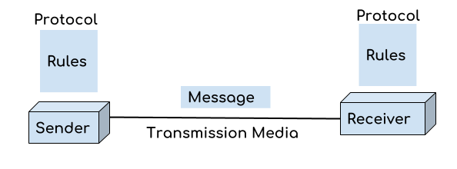
What is a Computer Network?
A group of two or more interconnected computer
Interconnection can be wired or wireless

Slide 8
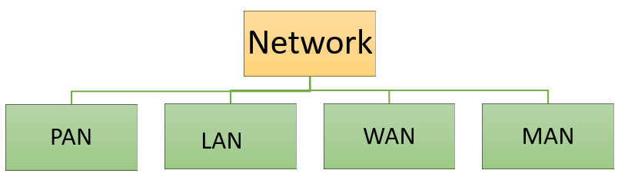
Types of Network?

Slide 9
PAN (Personal Area Network)
Personal devices network equipped within a limited area.
It can be wirelessly connected to the internet called WPAN.

Slide 10
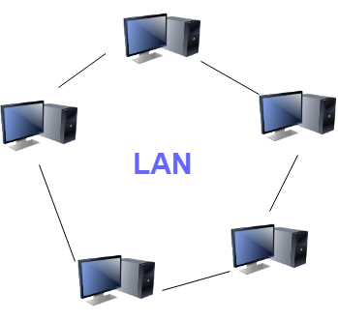
LAN (Local Area Network)
Network in a limited area such as school, laboratory, home, and office building.
It is limited to a single building or site

Slide 11
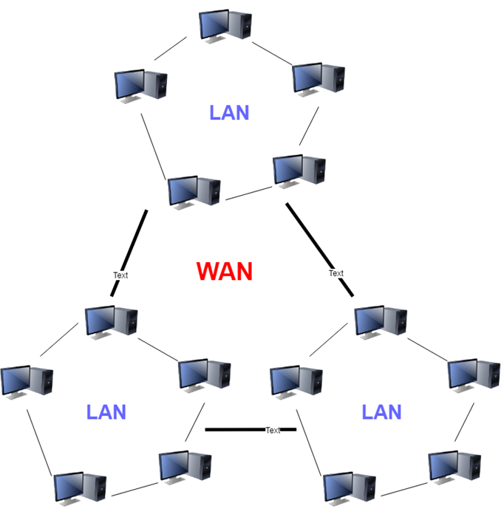
WAN (Wide Area Network)

Slide 12
WAN (Wide Area Network) (Cont…)
A network that is spread across a large geographical area
It is collection of LANs connected via telephone lines and radio waves

Slide 13
MAN (Metropolitan Area Network)
This type of network is large than a LAN and it could spread across a small region , college campus or an entire city.

Slide 14
Other Types of Network
WLAN (Wireless Local Area Network)
SAN (Storage-Area Network ): For storage
System-Area Network: LAN for server-to-server and processor-to- processor applications
EPN(Enterprise private network):
Campus Area Network (CAN) : A man for University campus
VPN(Virtual Private Network) :

Slide 15
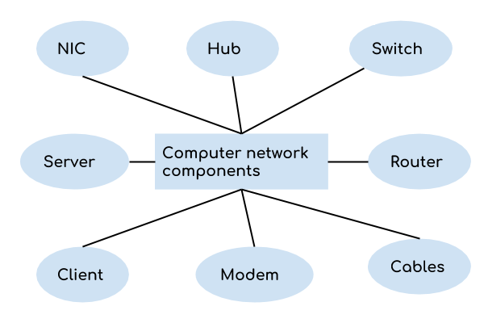
Computer Network Components

Slide 16
Essential Network Components
Component | Description
Switches | Connect devices to a network Allow device-to-device communication on a network Allow network-to-network communication on a
Routers | It connect multiple networks Enable you to share a single internet connection multiple devices Act as a dispatcher Allow to analyze data sent on network Select a best route for the data to be sent
Servers | Computers that hold shared programs, files, and the network operating system allow network users to access network resources .
Clients | They are also users of the network Computer devices which access and uses the network and its resources.

Slide 17
Essential Network Components (Cont…)
Component | Description
Transmission Media | It is a Cabling media used to connect devices to a network Coaxial cable, twisted-pair wire, and optical fiber cable Also known as links, channels, or lines
Access points | It allows wireless network connection of devices
Operating System | System of ware of client (client OS) device and Server (server OS) device
Protocol | It is set of defined rules that allows devices to communicate across the network (IP, TCP, UDP, FTP).
Hub | It acts a distribution center for multiple computers, Any information received by the hub transmitted to the entire network.
ARP | Address Resolution Protocol which convert the IP address into its corresponding Physical Address.
RARP | Reverse Address Resolution Protocol gives an IP address of the device with given a physical address as input.

Slide 18
Unique Network Identifiers
Component | Description
Hostname | Every device of the network is associated with a unique device, which is called hostname.
IP Address | unique identifier for each device on the Internet`
DNS Server | Domain Name System server translates URL or web addresses into their corresponding IP addresses.
MAC Address | Media Access Control Address is a physical address of NIC (Network Interface Card) of the host
Port | A logical channel which allows network users to send or receive data to an application. Each applications is identified using the port number on which they are running.

Slide 19
Uses of Computer Networks
Helps you to share resource such as printers
Allows you to share expensive softwares and database among network participants
Provides fast and effective communication from one computer to another computer
Helps you to exchange data and information among users via a network.

Slide 20
Advantages of Computer Networking
Helps you to connect with multiple computers together to send and receive information when accessing the network.
Helps you to share printers, scanners, and email.
Helps you to share information at very fast speed
Electronic communication is more efficient and less expensive than without the network.

Slide 21
Disadvantages of Computer Networking
initial set-up Investment for hardware and software can be costly
If you don’t take proper security precautions like file encryption, firewalls then your data will be at risk.
Requires time for constant administration and maintenance
Frequent server failure and issues of regular cable faults can be a nightmare

Slide 22
What is a Computer Topology?
A methods in which all the elements of a network are mapped.

Slide 23
Types of Networking Topologies
Logical topology
Physical topology

Slide 24
Logical Topologies
It gives insight about network’s physical design.
Common logical typologies are Peer to Peer and Client Server
The web (WWW) is a client server network at the logical level.

Slide 25
Peer-To-Peer
All nodes are equal and any node can talk to any other node.
This is used for small area (LAN)
Permission based security
This was the original networking model of windows networking. (windows for Workgroups)
Example of P2P are BitTorrent, Transfer of file via blue tooth device

Slide 26
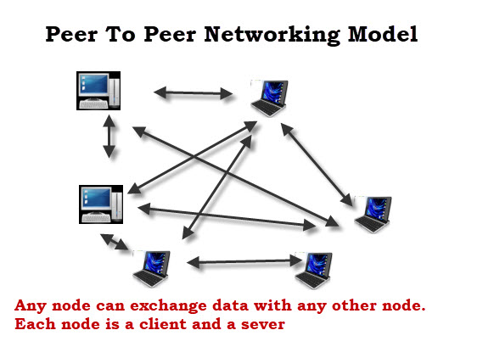
Peer-To-Peer (cont.)

Slide 27
Physical Topologies
Point to Point (P2P)
Bus Topology
Ring Topology
Star Topology
Mesh Topology
Tree Topology

Slide 28
Point to Point (P2P) Topology
The network consists of a direct link between two computers.
This is used for small areas where computers are in close proximity.
There is no security besides the permissions.

Slide 29
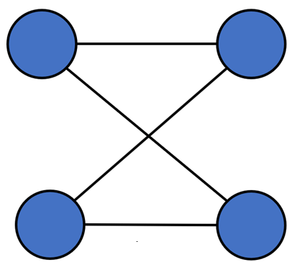
Point to Point (P2P) Topology (Cont…)

Slide 30
Bus Topology
A single cable (spine) is used to connect all the included nodes. One of the computers in the network acts as the computer server.
If spine fails, then the entire system will crash down.
Effective for small networks because it is simple to set up and utilizes shorter cables
Famous for LAN network

Slide 31
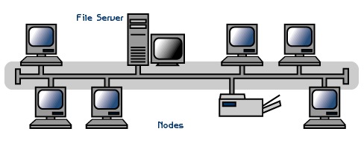
Bus Topology (Cont…)

Slide 32
Ring Topology
Formation of this topology is like a ring so it is call ring topology
Every computer is connected to another computer such that every computer has exactly two neighboring computer for communication purpose.
if one network cable fails, still data has an alternative path to reach its destination.

Slide 33
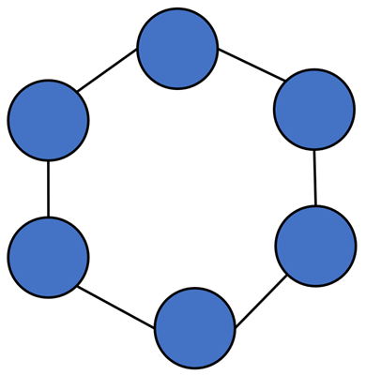
Ring Topology (Cont…)

Slide 34
Star Topology
All the computers connect with the help of a hub called concentrator and all other nodes communicate through this central node
Most popular on LAN networks

Slide 35
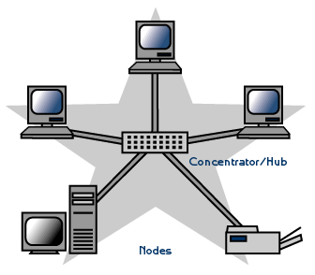
Star Topology (Cont…)

Slide 36
Mesh Topology
Each computer on the network connects to every other computer
It develops a P2P (point-to-point) connection between all the devices
If one network cable fails, still data has an alternative path to reach its destination.
It is expensive to implement and It requires a large space for implementation.

Slide 37
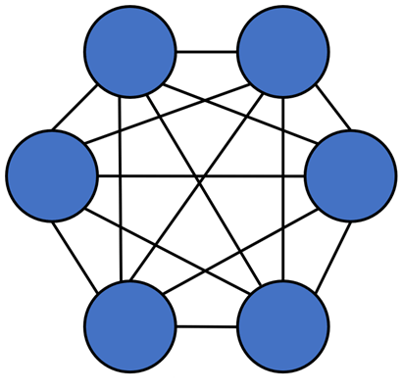
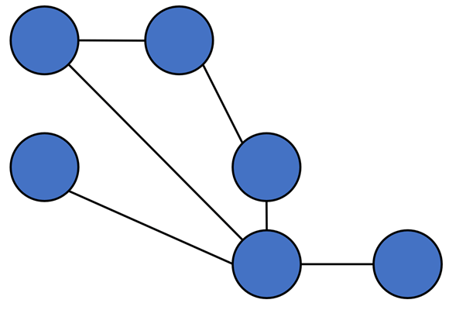
Mesh Topology (Cont…)
Mesh topology
Partial Mesh topology

Slide 38
Tree Topology
Tree topologies have a root node, and all other nodes are connected which form a hierarchy.
It is also known as hierarchical topology.
It integrates various star topologies together in a single bus
integrates various star topologies together in a single bus

Slide 39
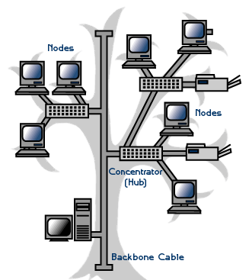
Tree Topology (Cont…)

Slide 40
Topology | Common Cable | Common Protocol
P2P | Twisted Pair, Fiber | Ethernet
Bus | Twisted Pair. Coaxial. Fiber | Ethernet
Ring | Twisted Pair, Fiber | Ethernet
Star | Twisted Pair, Fiber | Ethernet
Tree | Twisted Pair. Coaxial. Fiber | Ethernet
Mesh | Twisted Pair. Coaxial. Fiber | AHCP, DHCP

Slide 41
Web References
https://www.guru99.com/basic-computer-network.html
https://www.guru99.com/type-of-network-topology.html
http://www.steves-internet-guide.com/networking/
https://electricalfundablog.com/lan-local-area-network-topology-types/
https://www.guru99.com/types-of-computer-network.html#other-types-of-computer-networks
https://www.computerhope.com/jargon/l/linear-bus-topology.htm
https://fcit.usf.edu/network/chap5/chap5.htm
https://beginnersbook.com/2019/03/introduction-to-computer-network

